Slide 1
GTA Cat Encounters Monthly Report A demonstration of the officeverse in R
Jenny Rieck
27 March 2024
contact: jenny.rieck@gmail.com
materials: https://github.com/jennyrieck/auto-slide-deck-officer

Slide 2
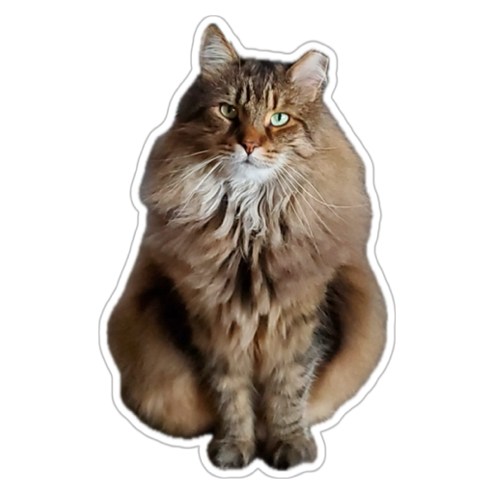
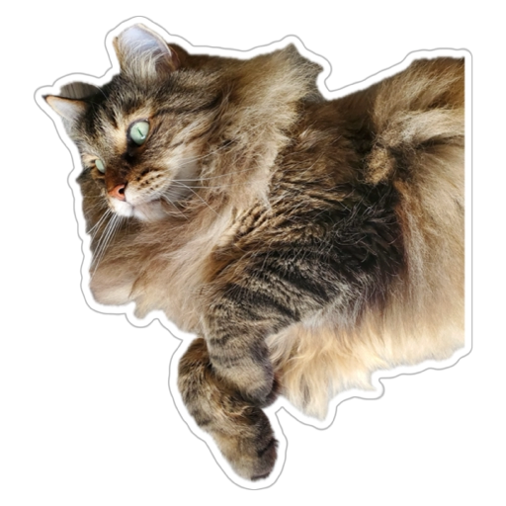
Data-driven decision making
We are making better use of the data and information collected during Cat Encounters (CEs) in the Greater Toronto Area (GTA) to inform decision-making and appropriate actions to increase positive cat experiences
1,128 CEs in the GTA from April 1, 2022 to March 31, 2023
45% of encounters involved Tabby cats and 24% involved Calico cats
August was the peak month for CEs, with an increase in CEs in the second half of the year
41% of CEs resulted in a Positive Experience outcome, up from 35% previously
Purr, Meow, and Stretch were the most frequent cat actions during Positive Experience CEs
Notes:
Slide 1 features bulleted text and images. unordered_list() can be used to create bulletpoints with different levels. external_img() allows you to insert image files into a picture location in your pptx template.

Slide 3
Characteristics of GTA Cats Encountered
1 Apr 2022 and 31 Mar 2023
Cat Breed
Cat Grade
Bengal (75 CEs)
100
Seal Point (99 CEs)
50
Tortie (179 CEs)
Calico (269 CEs)
0
Apr
May
Jun
Jul
Aug
Sep
Oct
Nov
Dec
Jan
Feb
Mar
22-23
22-23
22-23
22-23
Tabby (506 CEs)
Q1
Q2
Q3
Q4
Notes:
Slide 2 features editable plots made with ggplot2 and mschart. Wrapping the ggplot in dml() will turn the ggplot into a graphic vector in which design and text can be edited (left plot). ms_barchart() creates a native microsoft chart in which both chart design, text, and underlying data can be edited (right plot).

Slide 4

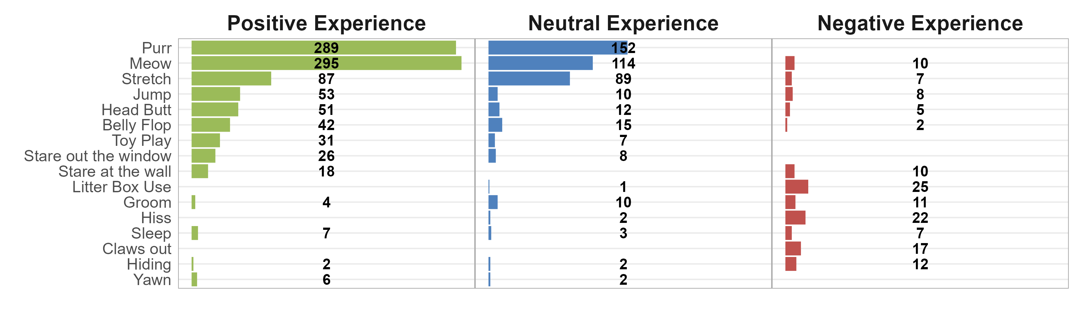
GTA Cat Encounter Outcomes
1 Apr 2022 and 31 Mar 2023
Cat Encounter Outcomes
Actions associated with Cat Encounter Outcomes
Notes:
Slide 3 features static plots made with ggplot2. Without wrapping the ggplots in dml(), the plots are saved as static image files in the final powerpoint.

